Slide 1
IE 362 Lecture 1: Matlab Review
Il-Chul Moon
Department of Industrial and Systems Engineering
KAIST

Slide 2
Matlab Introduction

Slide 3
Weekly Objectives
This week, we review Matlab that will be used for a programming language for this course.
Objectives are
Setting up the Matlab development environment
Executing “Hello world” program
Memorizing basic grammar of Matlab
Understanding Matlab programming structure
Understanding control and loop statements
Understanding function calls and class declarations
Understanding the reference of Matlab variables

Slide 4
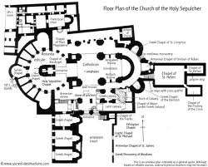


Programming and DS&A
What is programming to data structure and algorithm?
Programming is an implementation tool
Conceptual thinking and design
Where to put the restroom
How to find the restroom
Practical design and implementation
What to use for designing the restroom
How to move to the restroom
Both are important
Should pursue good design and good implementation
Good design and bad implementation?
Bad design and good implementation?

Slide 5

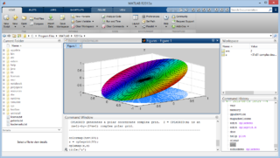
MATLAB
MATLAB
Development started in 1970s
First release in 1984
Interpreter
Recently, stated supporting object-oriented
Dynamic type of variables
Mainly used in math intensive environments: engineering, science, economics…
Not a generic programming, though MATLAB can be used for generic tasks
Very strong and frequently used in intensive computations..
Prototyping language
See how your mathematical model works
Run your statistical analyses
Easily and quickly
Fast development speed, slow execution speed

Slide 6
Getting prepared with MATLAB
Documentations
Official materials from MathWorks
files uploaded on the course homepage
MATLAB Primer
MATLAB Creating Graphical User Interfaces
MATLAB Object Oriented Programming
MATLAB Statistics toolbox
MATLAB Central : sample code and useful utilities
http://www.mathworks.co.kr/matlabcentral/
Interactive tutorials
http://www.mathworks.co.kr/academia/student_center/tutorials/register.html (120 min)
YAGTOM
Yet Another Guide TO Matlab by Google
http://code.google.com/p/yagtom/

Slide 7
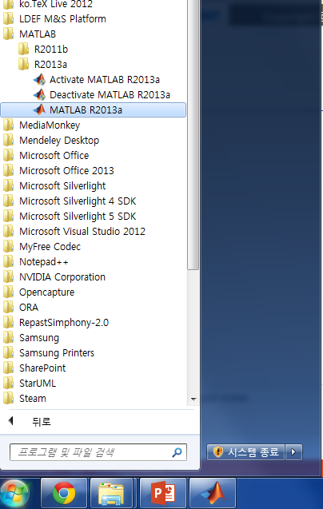

Matlab Installation and Execution
We are going to use MATLAB R2013a
You can get this from the below website
http://kftp.kaist.ac.kr
Follow the installation instruction
On the website
In the attached PDF file
You can find these in the above website
Once you install the Matlab
Run the Matlab

Slide 8
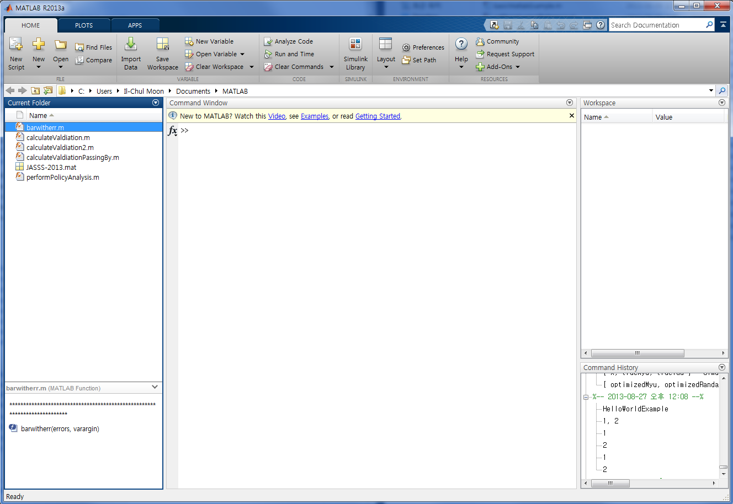
Programming Environment
Program File Lists
Variables in Memory
Main Console
(Your Playground!)
Recent Commands
Selected File Details

Slide 9
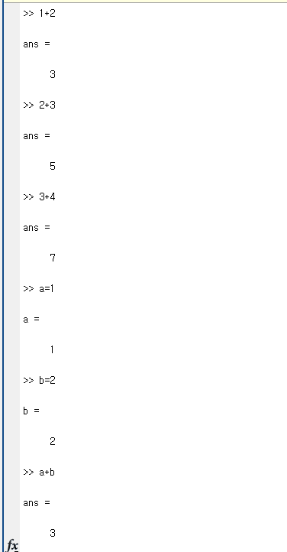
Very Simple Matlab Command
You can use the mathematical notations as you use calculator
+, -, *, /
You can assign a value to a variable
Value: 1, 2, 3, 4, ln2, exp(5)…..
Variable
A memory place that can hold a value at a certain time
Define a variable
Not in this case
Dynamic definition of “a” and “b”
Assign a value
“a=1”
Use a value
“a+b”

Slide 10
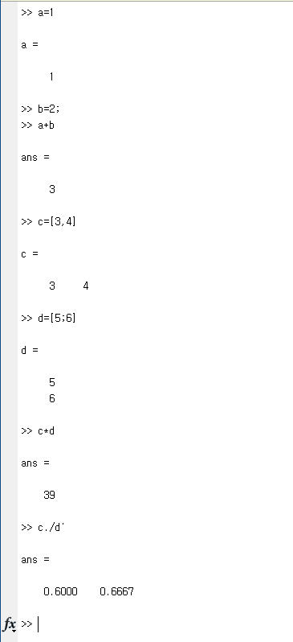
Basics of MATLAB
Matlab is a computation oriented programming tool
Has been known to excellent performance on handling matrices.
Computation is a task with
Operator: what to do?
+, -, *, /
Operand: with what?
Scalar
1, 2, 3…
Vector
[1, 2]
Matrix
[1, 2 3, 4 ]

Slide 11
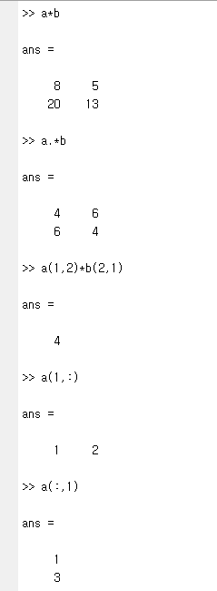
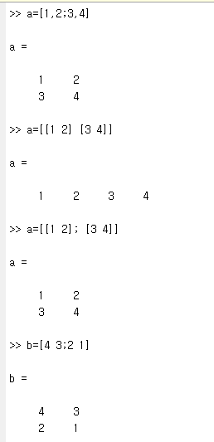
Defining and Handling Matrices
A vector vs. a matrix
Separating a column
Blank or comma
Separating a row
Semicolon
Difference between * and .*
*
Typical matrix calculation
.*
Array based matrix calculation
Specifying a cell
a(1,2)
Parenthesis and comma
a(1,:) and a(:,1)

Slide 12
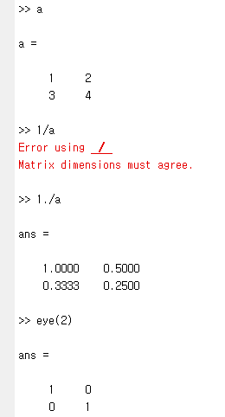
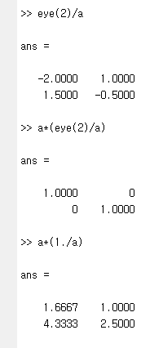
Operations on Matrices
Division works same as * and .*
/ and ./
There is no .+ and .-
Why?
Special matrix
eye(2)
Identity matrix
Compare the element-wise operation and the matrix-wise operation
a*(1/a) = 1
Scalar case is easy
Matrix case?

Slide 13
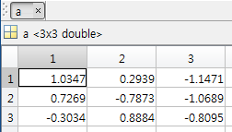
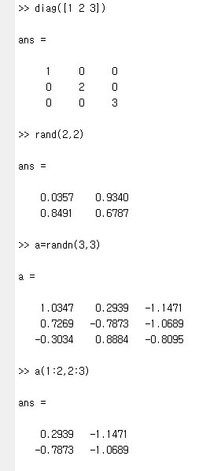
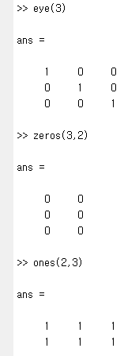
Special Matrices
Special matrix
eye(2)
Identity matrix
zeros(2,2)
ones(2,2)
diag([1 2 3])
Diagonal matrix
rand(2,2)
Random matrix from uniform distribution (0,1)
randn(2,2)
Random matrix from normal distribution
Subrange of matrices
a(1:2,2:3)

Slide 14
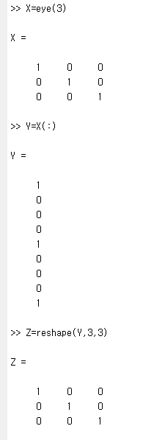
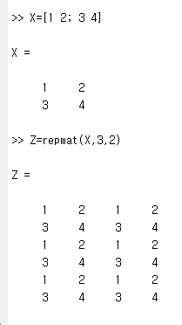
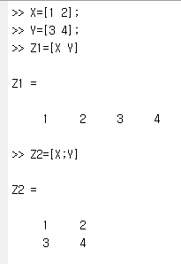
More Matrix Manipulations
Concatenation
X=[1 2]
Y=[3 4]
Z1 = [ X Y ]
Z2 = [ X ;Y ]
Reshape
X=eye(3)
Y=X(:)
Z=reshape(Y,3,3)
Replication
X=[1 2 ; 3 4]
Z=repmat(X,3,2)

Slide 15
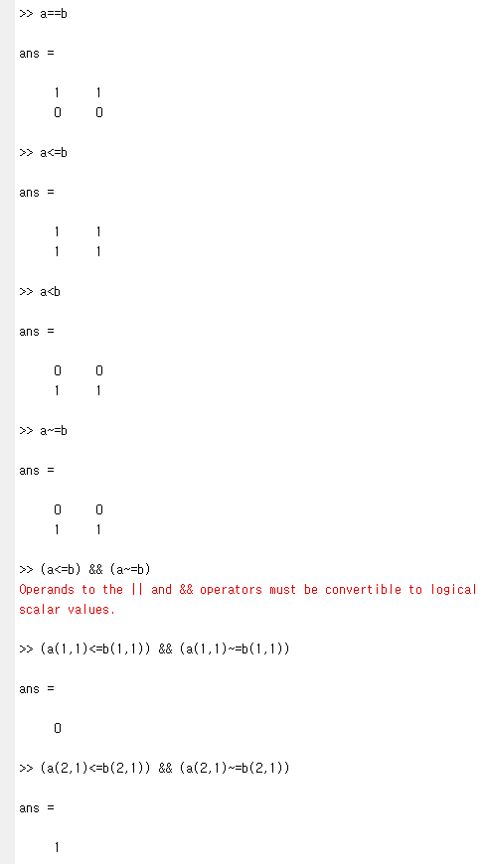
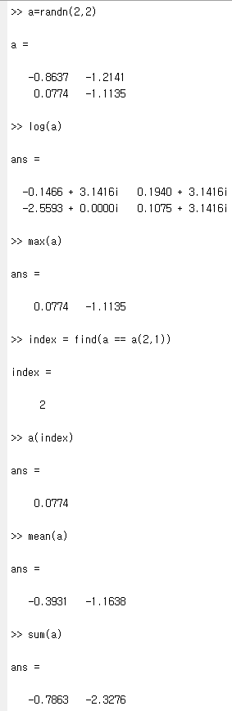
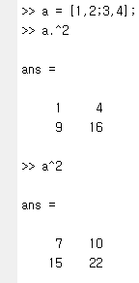
Diverse Operators
Arithmetic operators
+, -, *, /, .*, ./, ^, .^
Logical operators
==, >, >=, ~=
&&, ||, ~
Functions
log
find
max
min
mean
std
sum
cumsum
prod
cumprod
diff

Slide 16
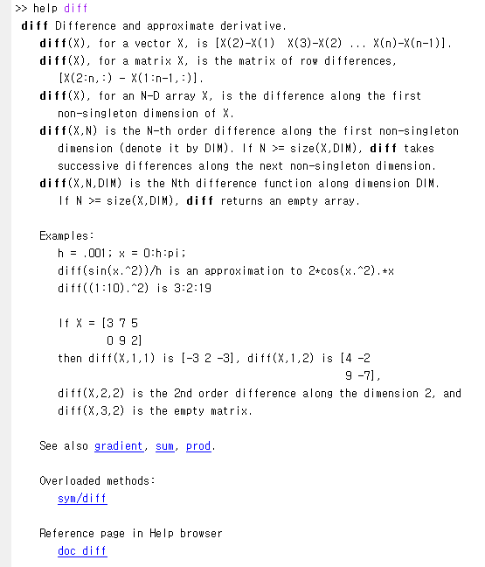
When you don’t know a function…
Write
help <function>
help diff
help cumsum
help prod
Matlab help comes with
Examples
Parameter lists
Related functions
There is a web version
http://www.mathworks.co.kr/kr/help/matlab/

Slide 17
Hello world in Matlab

Slide 18
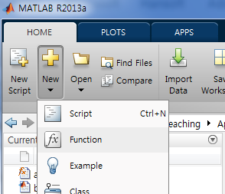
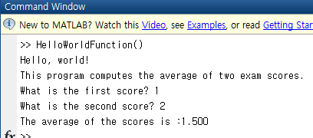
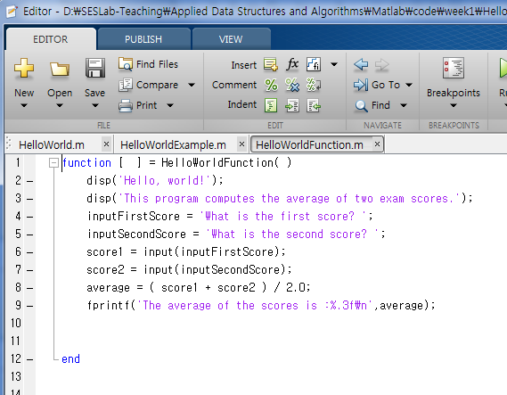
Hello World in Matlab
Previous was a set of commands
Not really a program
Your first Matlab program in this class
Procedure-oriented program
main() is a function
Largely in two parts,
Definition part
Execution part
Make sure that you save this file as “HelloWorldFunction.m”

Slide 19
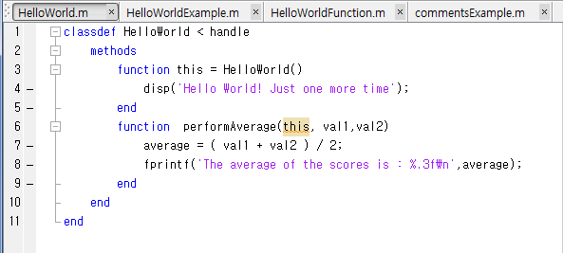
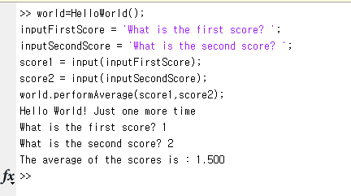
Matlab Program Structure - Another Hello World
Your second Matlab program in this class
Object-oriented program
HelloWorld is an object
HelloWorld and performAverage are methods
Largely in two parts
Definition part
Execution part

Slide 20

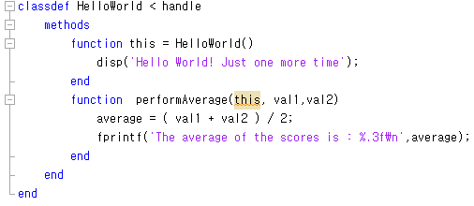
Naming and Styling
Naming : Use names clearly conveying the meaning
Use camel casing
Class name : Noun for the concept to be represented by the class
Capitalize the first letter of each word
e.g. classdef MyFirstClass < handle
Variable name : Noun for the contents to be stored
Start with lower case
e.g. numberOfStudents = 100
e.g. numStudents = 100
Method name : Verb for the method action
Start with lower case
e.g. function performAverage (this,val1,val2 ):
Indentation
4 spaces per each level

Slide 21
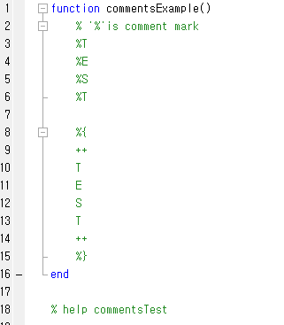
Comments
Single Line Comments
Block Comments
Comments are used for
Explain your codes to others
Note your ideas
Declare copyrights, etc
Writing comments is critical
For TA → your future boss
For your friends → your future colleagues
For yourself → yourself in future
Different types of comments

Slide 22
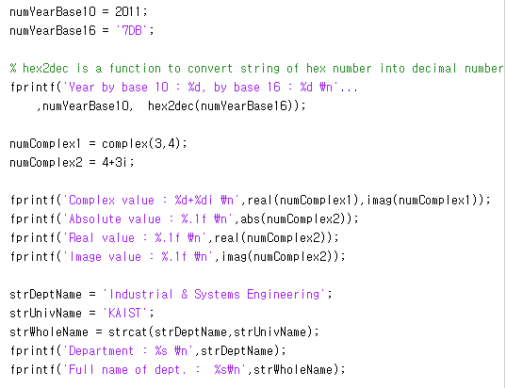
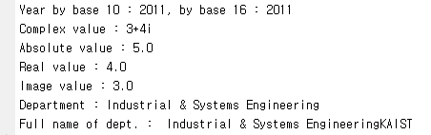
Variable Statements
Integer in decimal, octal, and hexadecimal
See the naming style
See the naming style
Complex numbers

Slide 23
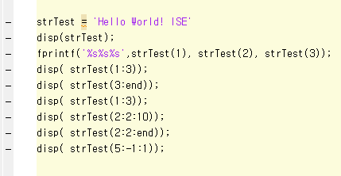
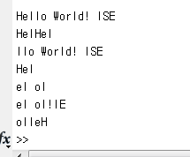
String
H | e | l | l | o |  | W | o | r | l | d | ! |  | I | S | E
1 | 2 | 3 | 4 | 5 | 6 | 7 | 8 | 9 | 10 | 11 | 12 | 13 | 14 | 15 | 16
String variable statements
‘ is used as a wrapper
String variable is actually a linear collection of letters, and the letters have indexes
You can use a simple iteration technique with :
See how a negative iteration works

Slide 24
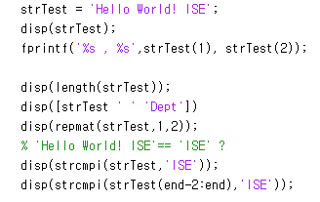
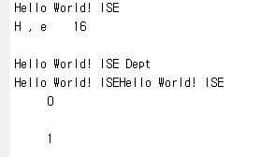
More on Strings
H | e | l | l | o |  | W | o | r | l | d | ! |  | I | S | E
1 | 2 | 3 | 4 | 5 | 6 | 7 | 8 | 9 | 10 | 11 | 12 | 13 | 14 | 15 | 16
Simple string concatenation
Length of the string
String as a matrix
String comparison

Slide 25
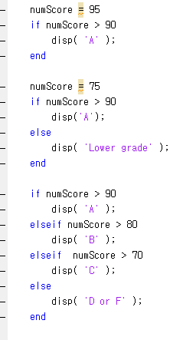
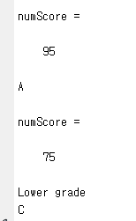
if
A condition statement
if boolean
Statements for True
elseif boolean
Statements for True
else
Statements for False
end
Matlab have a switch-case statement
You might consider using it when you have many ifs
Watch your indentations carefully

Slide 26
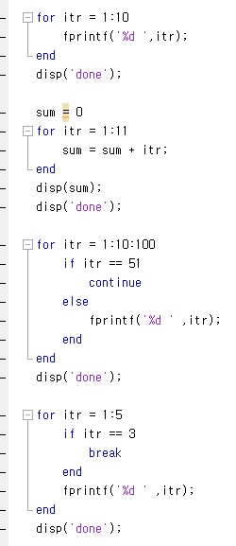
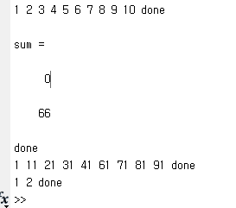
for
A loop statement
The most common loop statement in programming languages
for idx=values in vector:
Statements for loop
end
Some useful statements for loops
continue
break

Slide 27
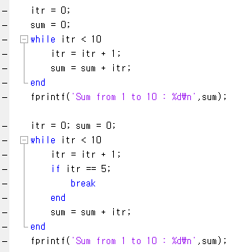

while
Second loop statement
Syntax is
while boolean
Statements for loop
else:
Still you can use the two loop control statements
continue
break

Slide 28
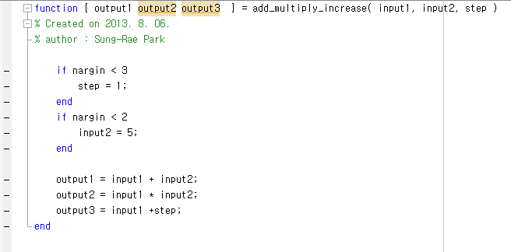
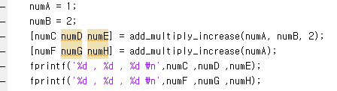

Function Statement
function [ return variables] = name(params)
statements
end
You can return multiple variables
Keep them in order

Slide 29
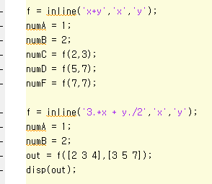


Inline Functions
functionName = inline(‘x+y’,’x’,’y’)
inline specifies that this is an inline function
The number of parameters for the function is specified
Later, you can just call the function with the functionName
Or,
You can use a shortened version
f=@(x,y) 3.*x+y./2;
The function name is called
Function handle

Slide 30
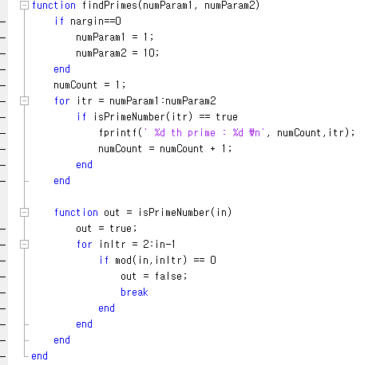
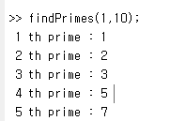
Sample Program: Finding Prime Numbers
Statements for iteration
Function for calculation
Triggers the execution

Slide 31
Class and Instances in Matlab

Slide 32
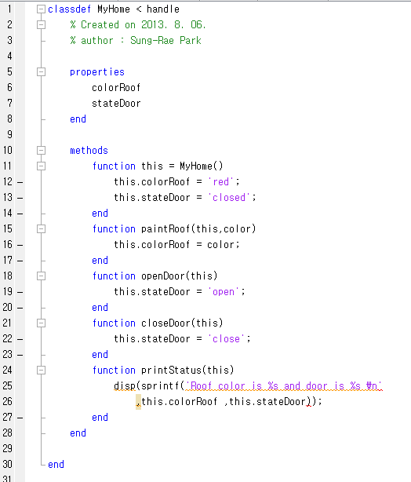






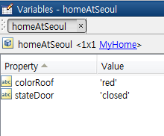

Class and Instance
See how to define a class → classdef classname < classname
Instantiation

Slide 33
Important Elements in Class
Important elements
Properties
Attributes
Member variables
Hold the important information of the class
Methods
Functions
Member functions
Specify what to do when the class behaves
Special method
Constructor
Execute when a class is instantiated
Use the class name as the method name

Slide 34
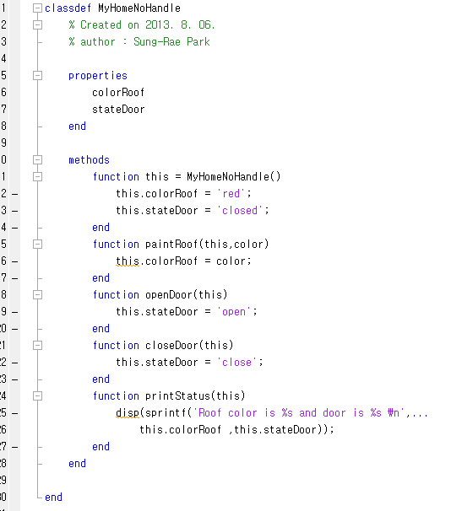
Class with Handle and without Handle
“< handle” means that it inherits the Object in Matlab world
What happens without “< handle”?
Matlab recognizes it as a value, not a reference…

Slide 35
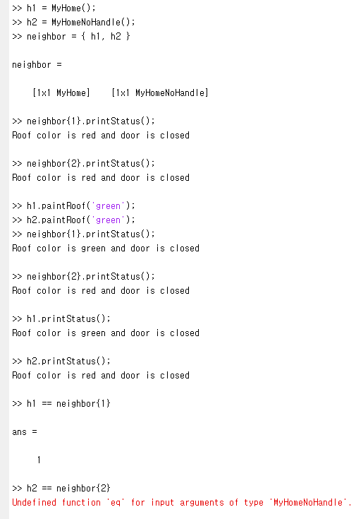
Short Experiment with Handles
Create two instances
h1 is from handle
h2 is not defined with handle
{ }
This is used to hold an array
Little different from a vector
You can hold diverse value types and classes with the array
When you call a “paintRoof”
h1 works
h2 does not work
Why?
Because
h1 is a reference
h2 is a value

Slide 36
Difference Between Handle and Value
h1
(MyHome)
h2
(MyHomeNoHandle)
Value copied
neighbor
(Cell Array)
neighbor{1}
neighbor{2}
(MyHome)
With “< handle”
Without “< handle”
Without “< handle”
Matlab always leaves the original value untouched
Matlab instead copies the original value to the new variable
With “< handle”
Matlab always stores and touches the single variable

Slide 37
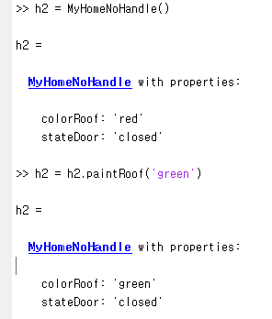
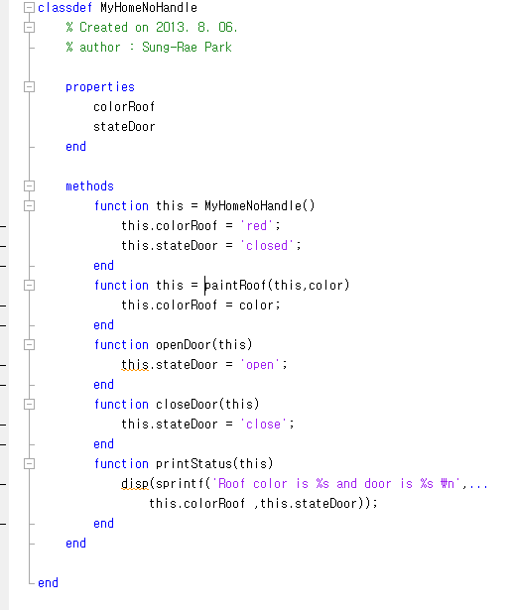
How to Change Value Class Properties
Receive a return value
The modified value class
“this”
What you are doing is creating another copy of instance with changed properties

Slide 38
Further reading
Interactive tutorials
http://www.mathworks.co.kr/academia/student_center/tutorials/register.html (120 min)
YAGTOM
Yet Another Guide TO Matlab by Google
http://code.google.com/p/yagtom/

